Slide 1
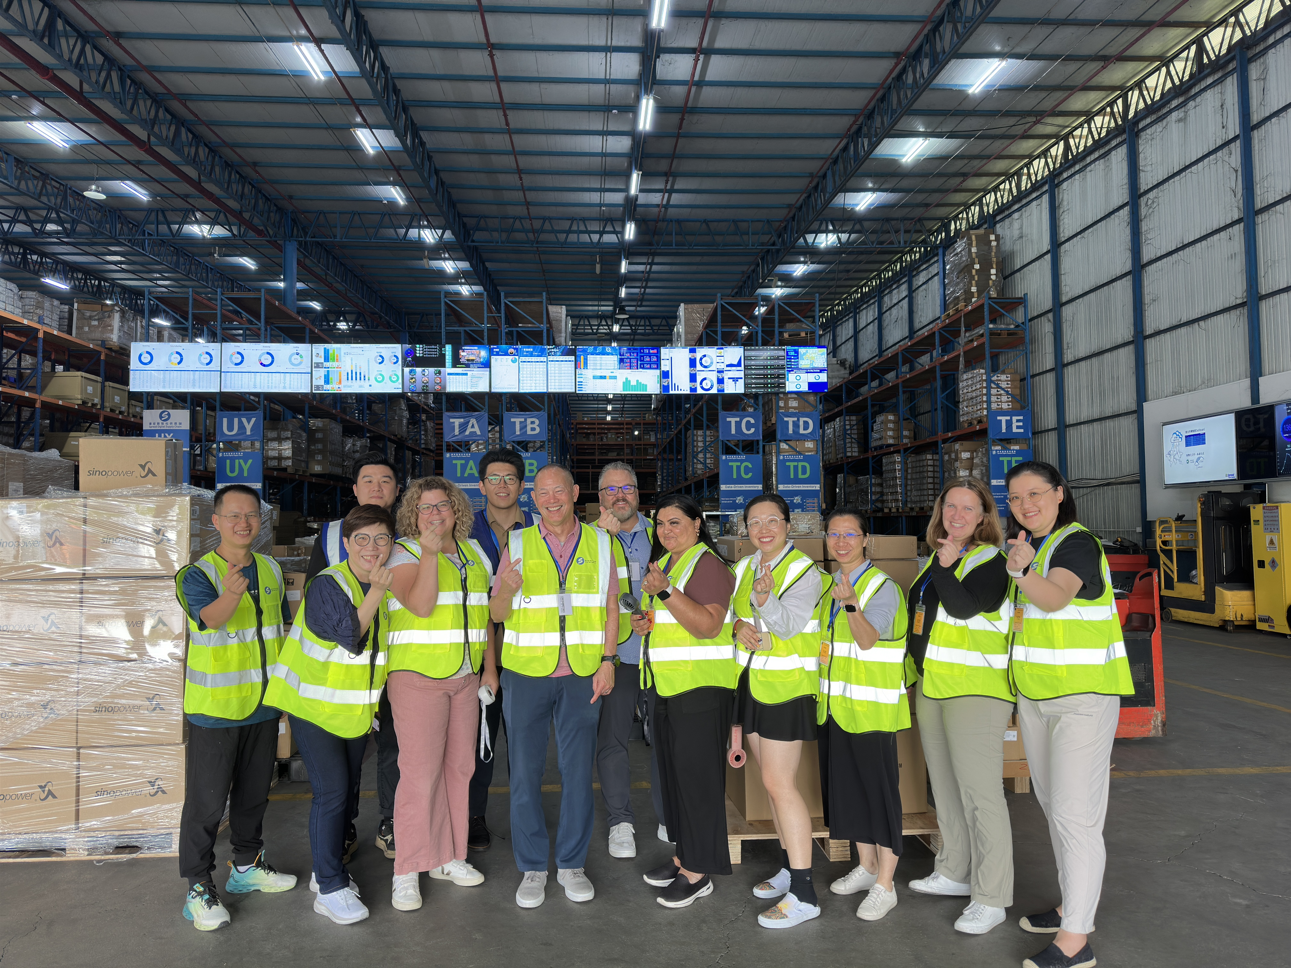


Amazon Material Team visiting Spread Hong Kong
2024 Business Review
2024/10/08

Slide 2
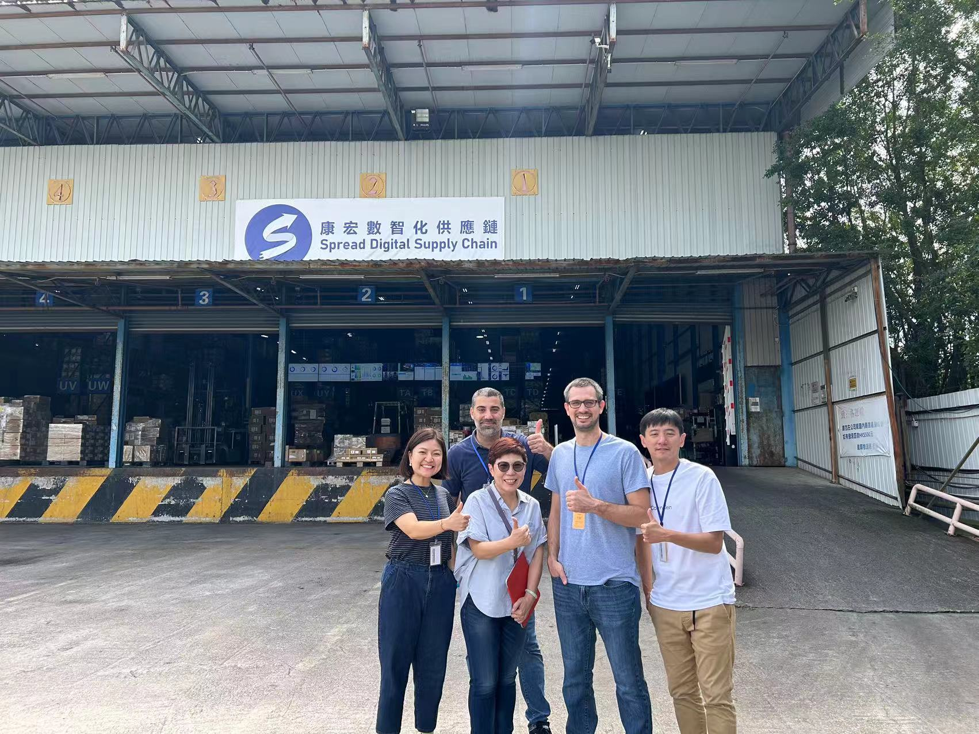
Amazon Material Team visiting Spread Hong Kong
Material Team
Alex, Ghassan, Vicky, Willy
and Roger
2023/10/26

Slide 3
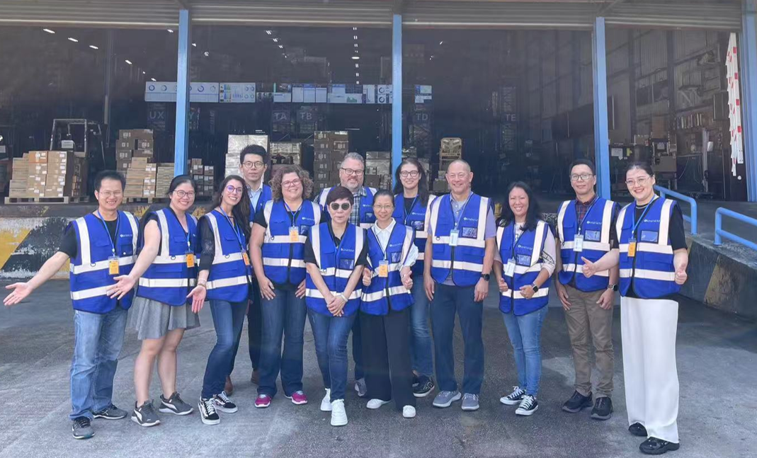
Amazon RL Team 2023/Q3 QBR with Spread Hong Kong
Welcome
Colleen
Chris
Sha
Ken
Maggie
Pinar
Alison
Leo
Mindy
Wendy
Sherry
Roger
2023/11/03

Slide 4
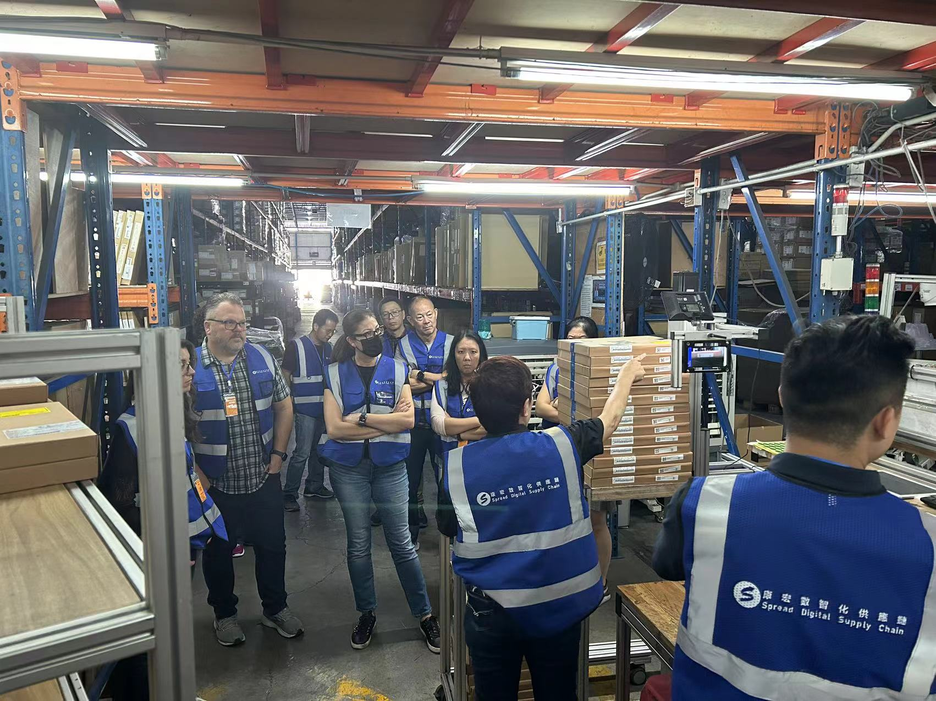
Amazon RL Team 2023/Q3 QBR with Spread Hong Kong
Site Tour
Jenny demonstrates Spread
Intelligent Hardware for Sorting:
Smart Scan 3.0

Slide 5
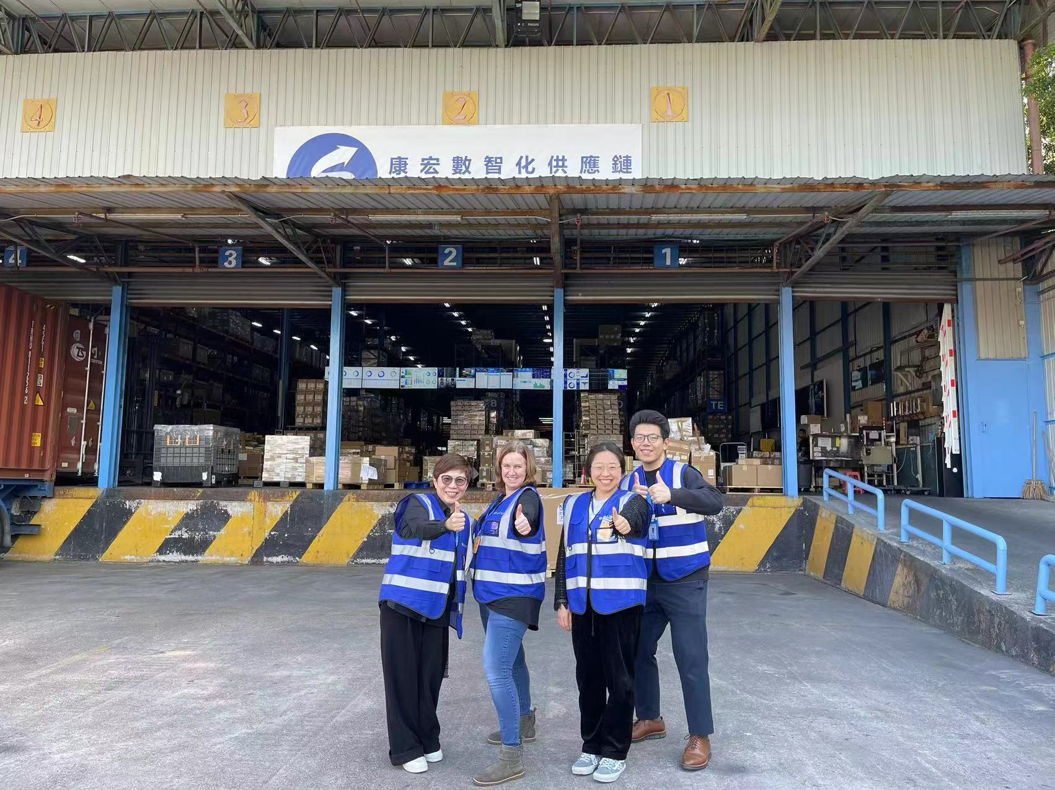
Amazon RL Sustainable Team Visit
Welcome
Ofira and Sherry
2024/01/08

Slide 6
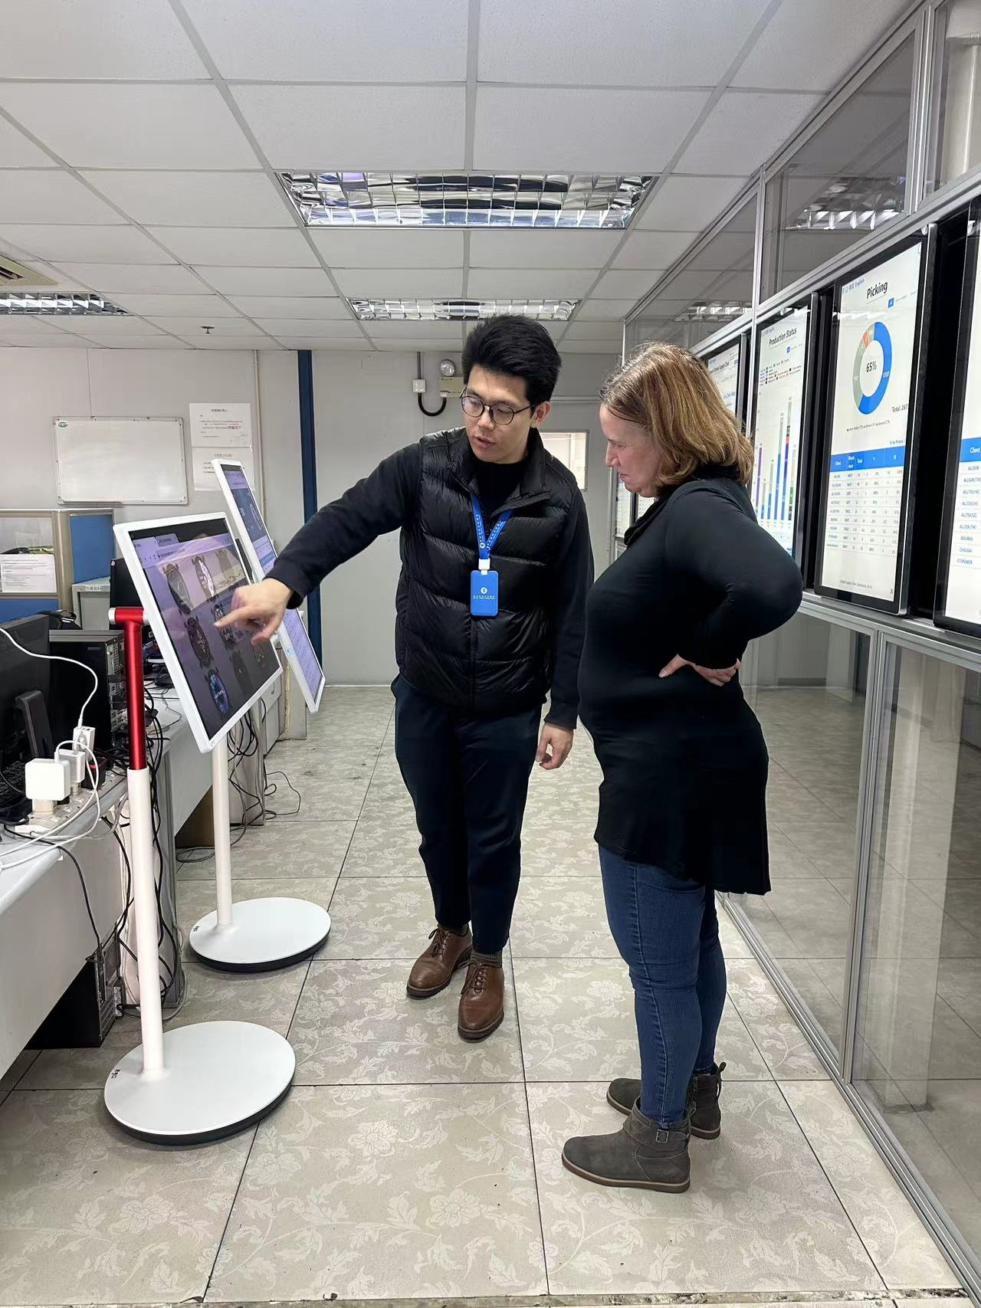
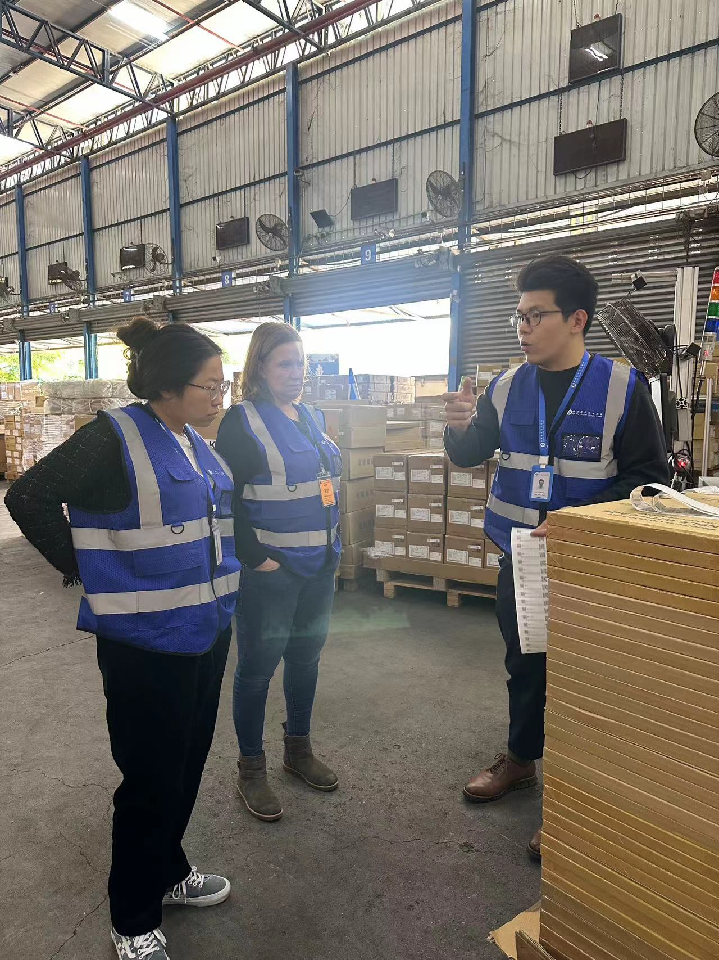
Amazon RL Sustainable Team Visit
Site Tour
Introduce Spread’s
“Real-Time”
&
“Data-Driven”
Dashboards & Operation
2024/01/08

Slide 7
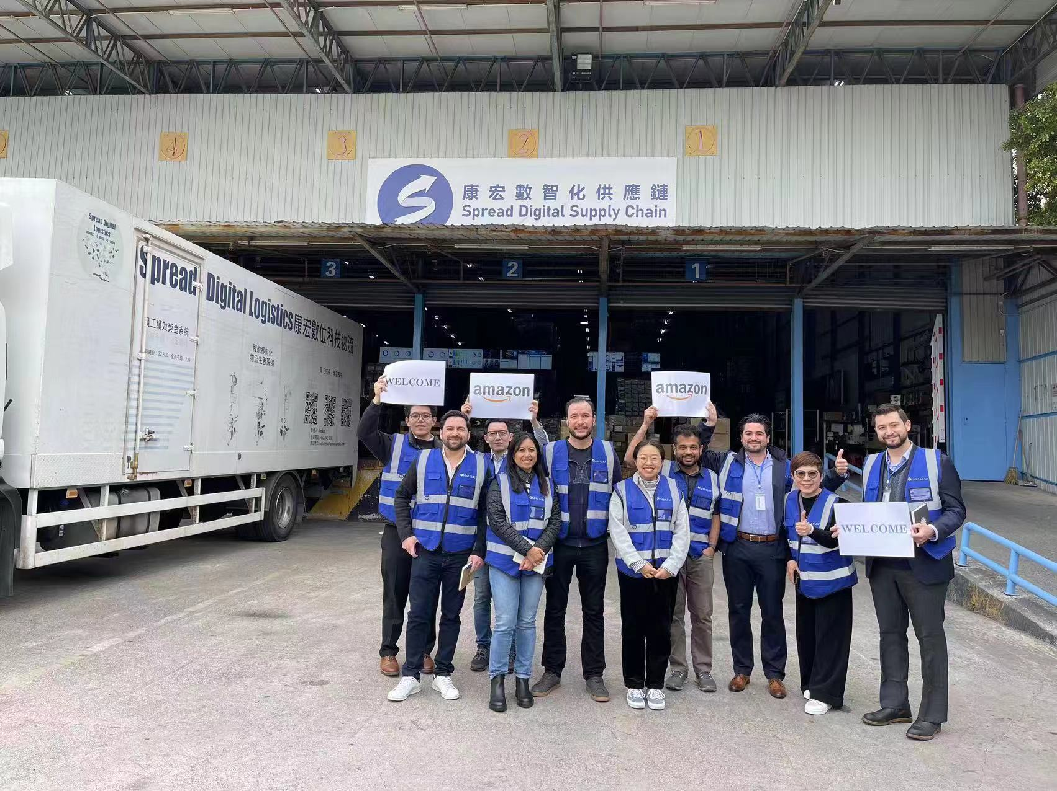
Amazon RL Engineer Team visiting Spread Hong Kong
Welcome
Joel
Sai Hari
Clarissa
Baulio
Wilfrido
Sherry
2024/1/22

Slide 8
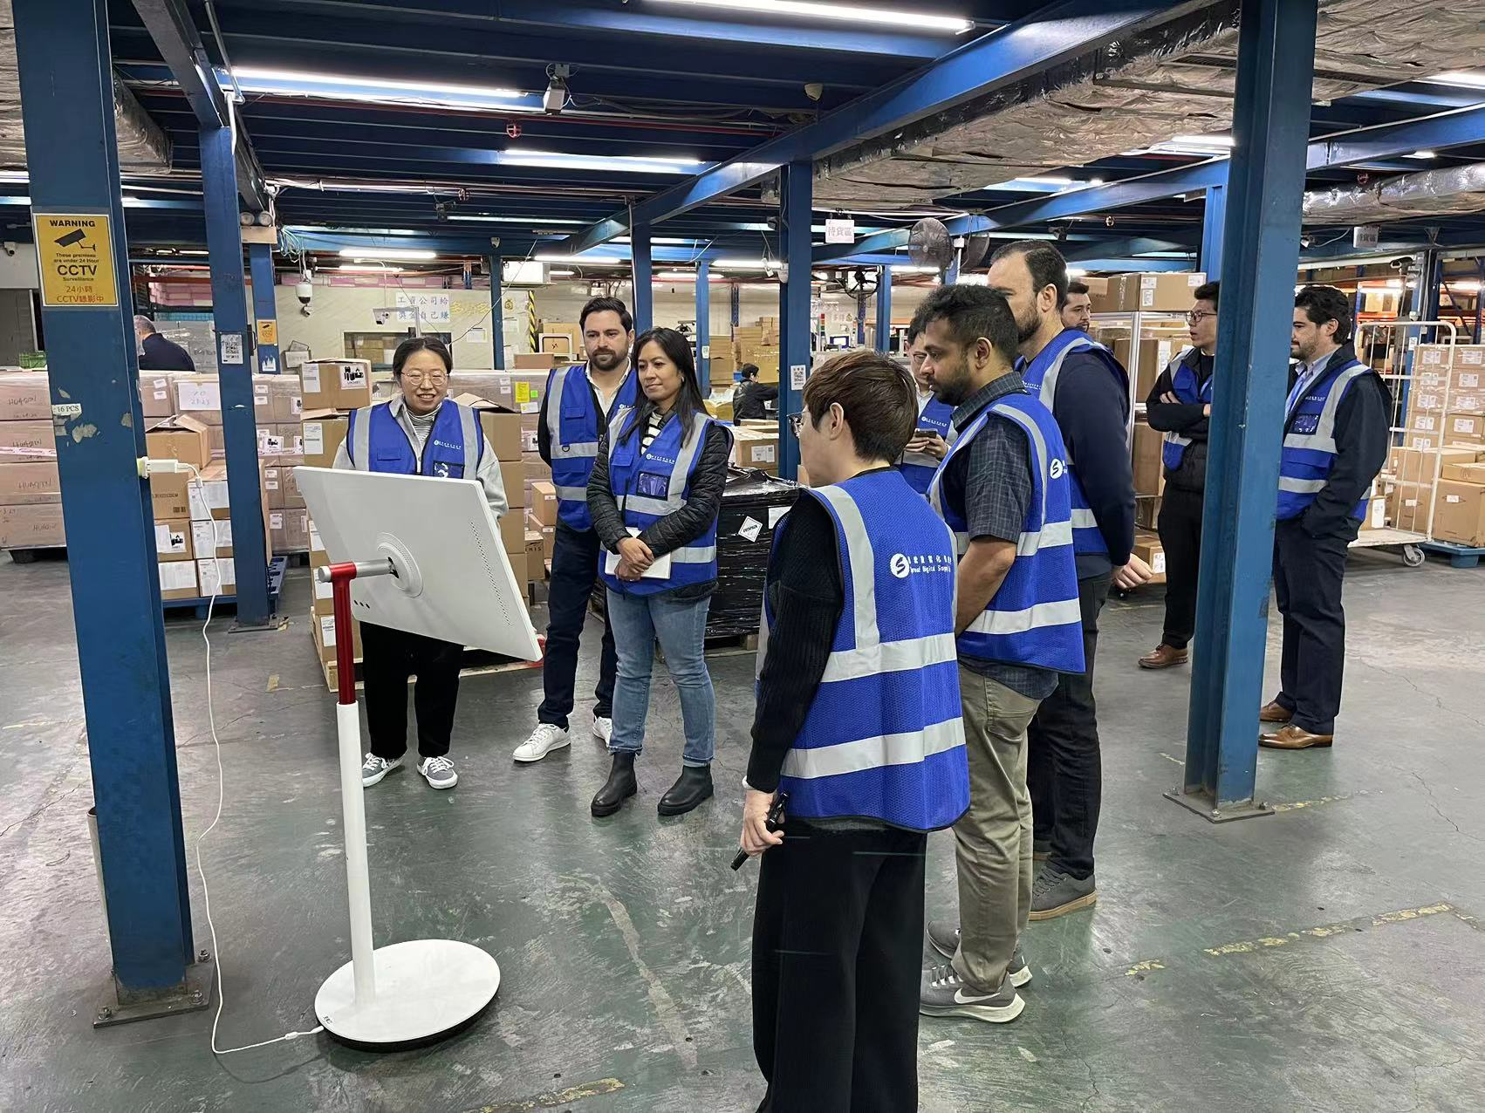
Amazon RL Engineer Team visiting Spread Hong Kong
Engineering Team
Introduce Spread’s
“Real-Time”
&
“Data-Driven”
Amazon E2E
Dashboard
2024/1/22

Slide 9
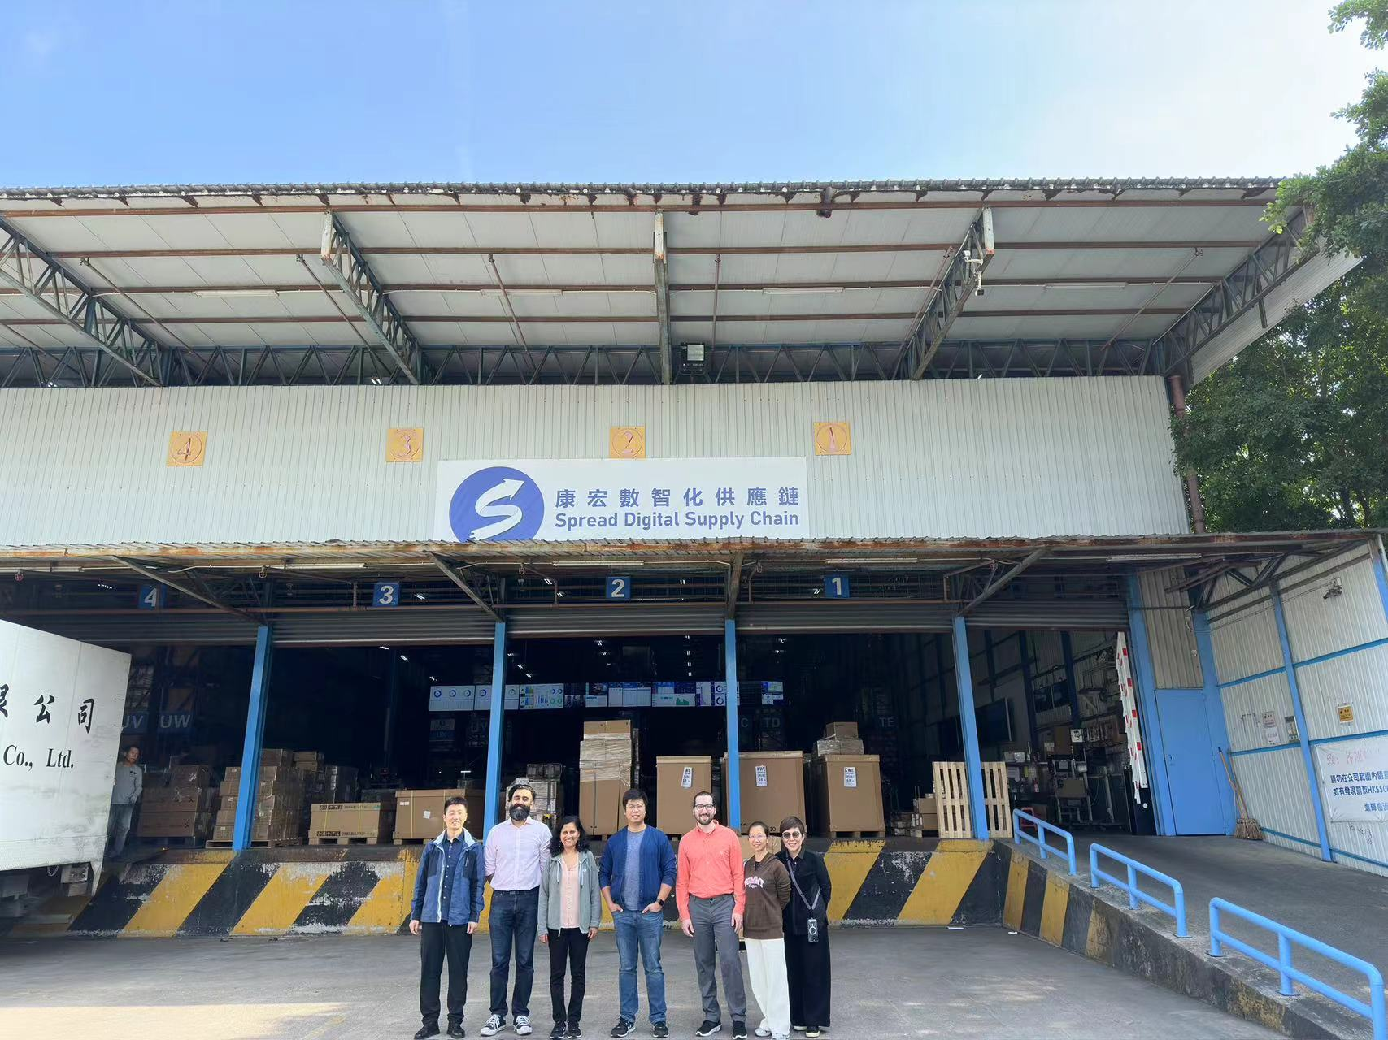
Amazon RL & DOTS Team visiting Spread Hong Kong
Welcome
Abbas
Annie
Levi
Tu
Wendy
2024/2/26

Slide 10
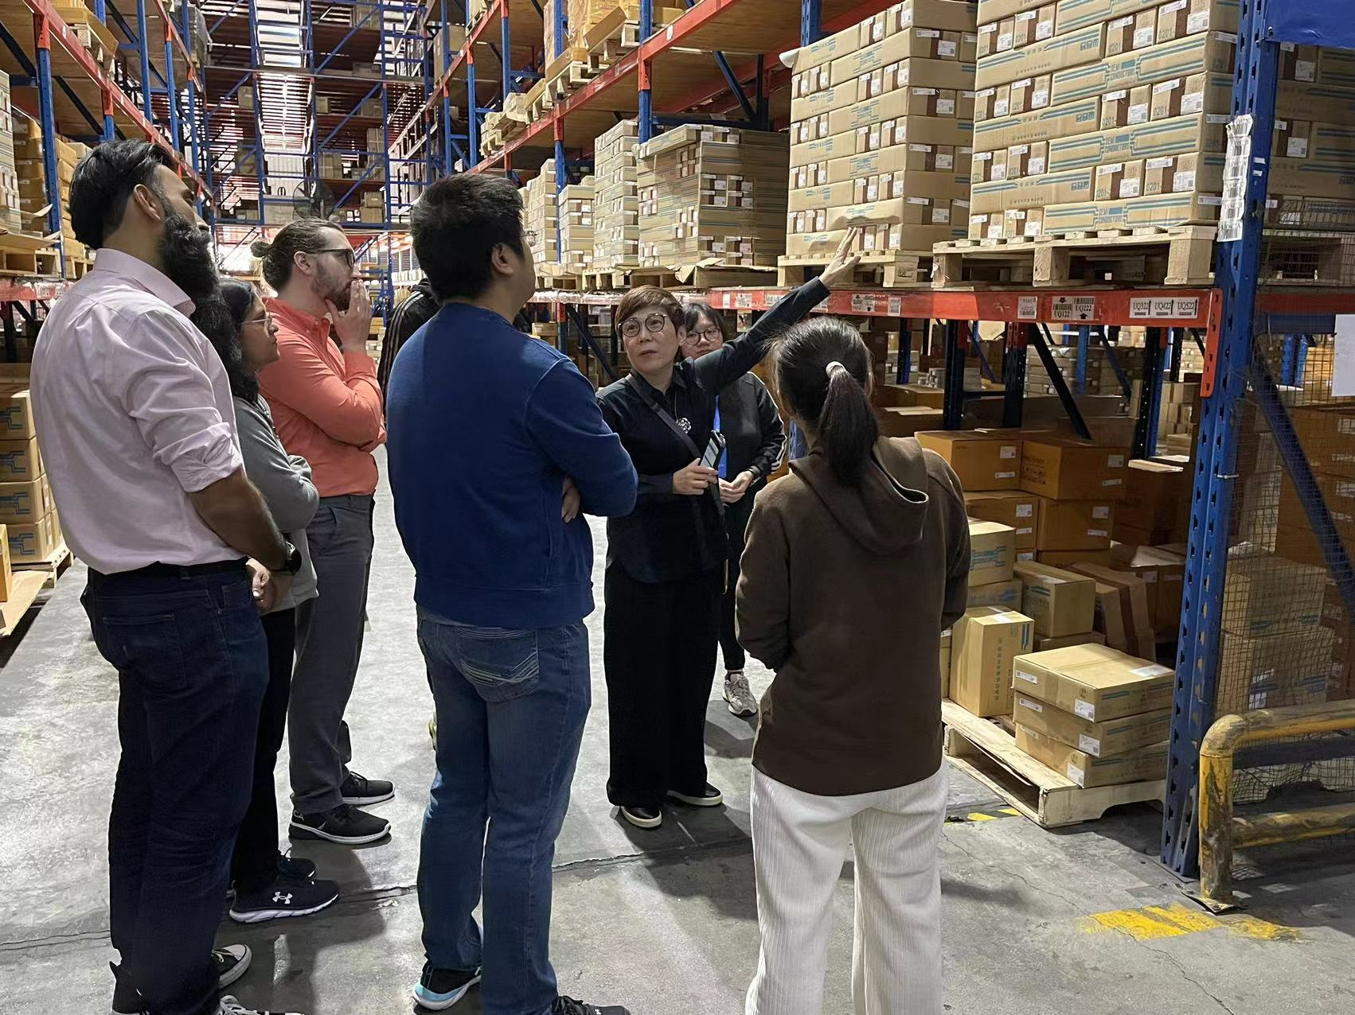
Amazon RL & DOTS Team visiting Spread Hong Kong
Phase Three
Introduce Spread’s
“Real-Time”
&
“Data-Driven”
Stock Count
2024/2/26

Slide 11
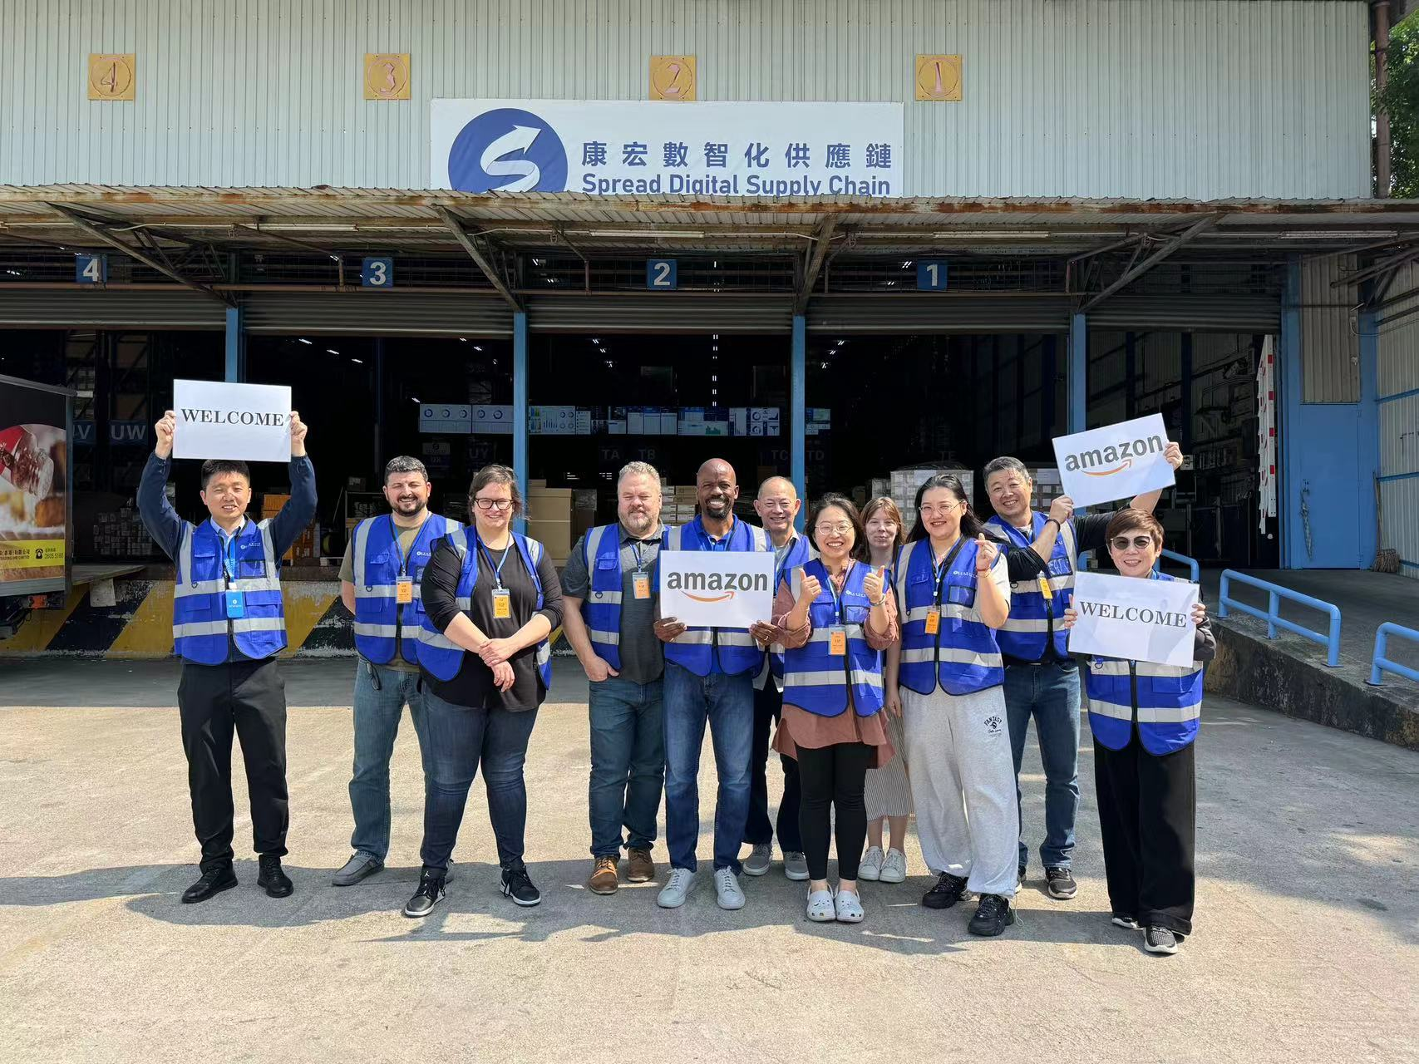
Amazon RL Team 2023/Q4 QBR with Spread Hong Kong
Welcome
Chris Moore
Ken Jew Andrew Choi
Chris Monte
Norah Foley
Lexi Knirlberger
Leroy Doby
Mindy
Sherry
2024/03/21

Slide 12
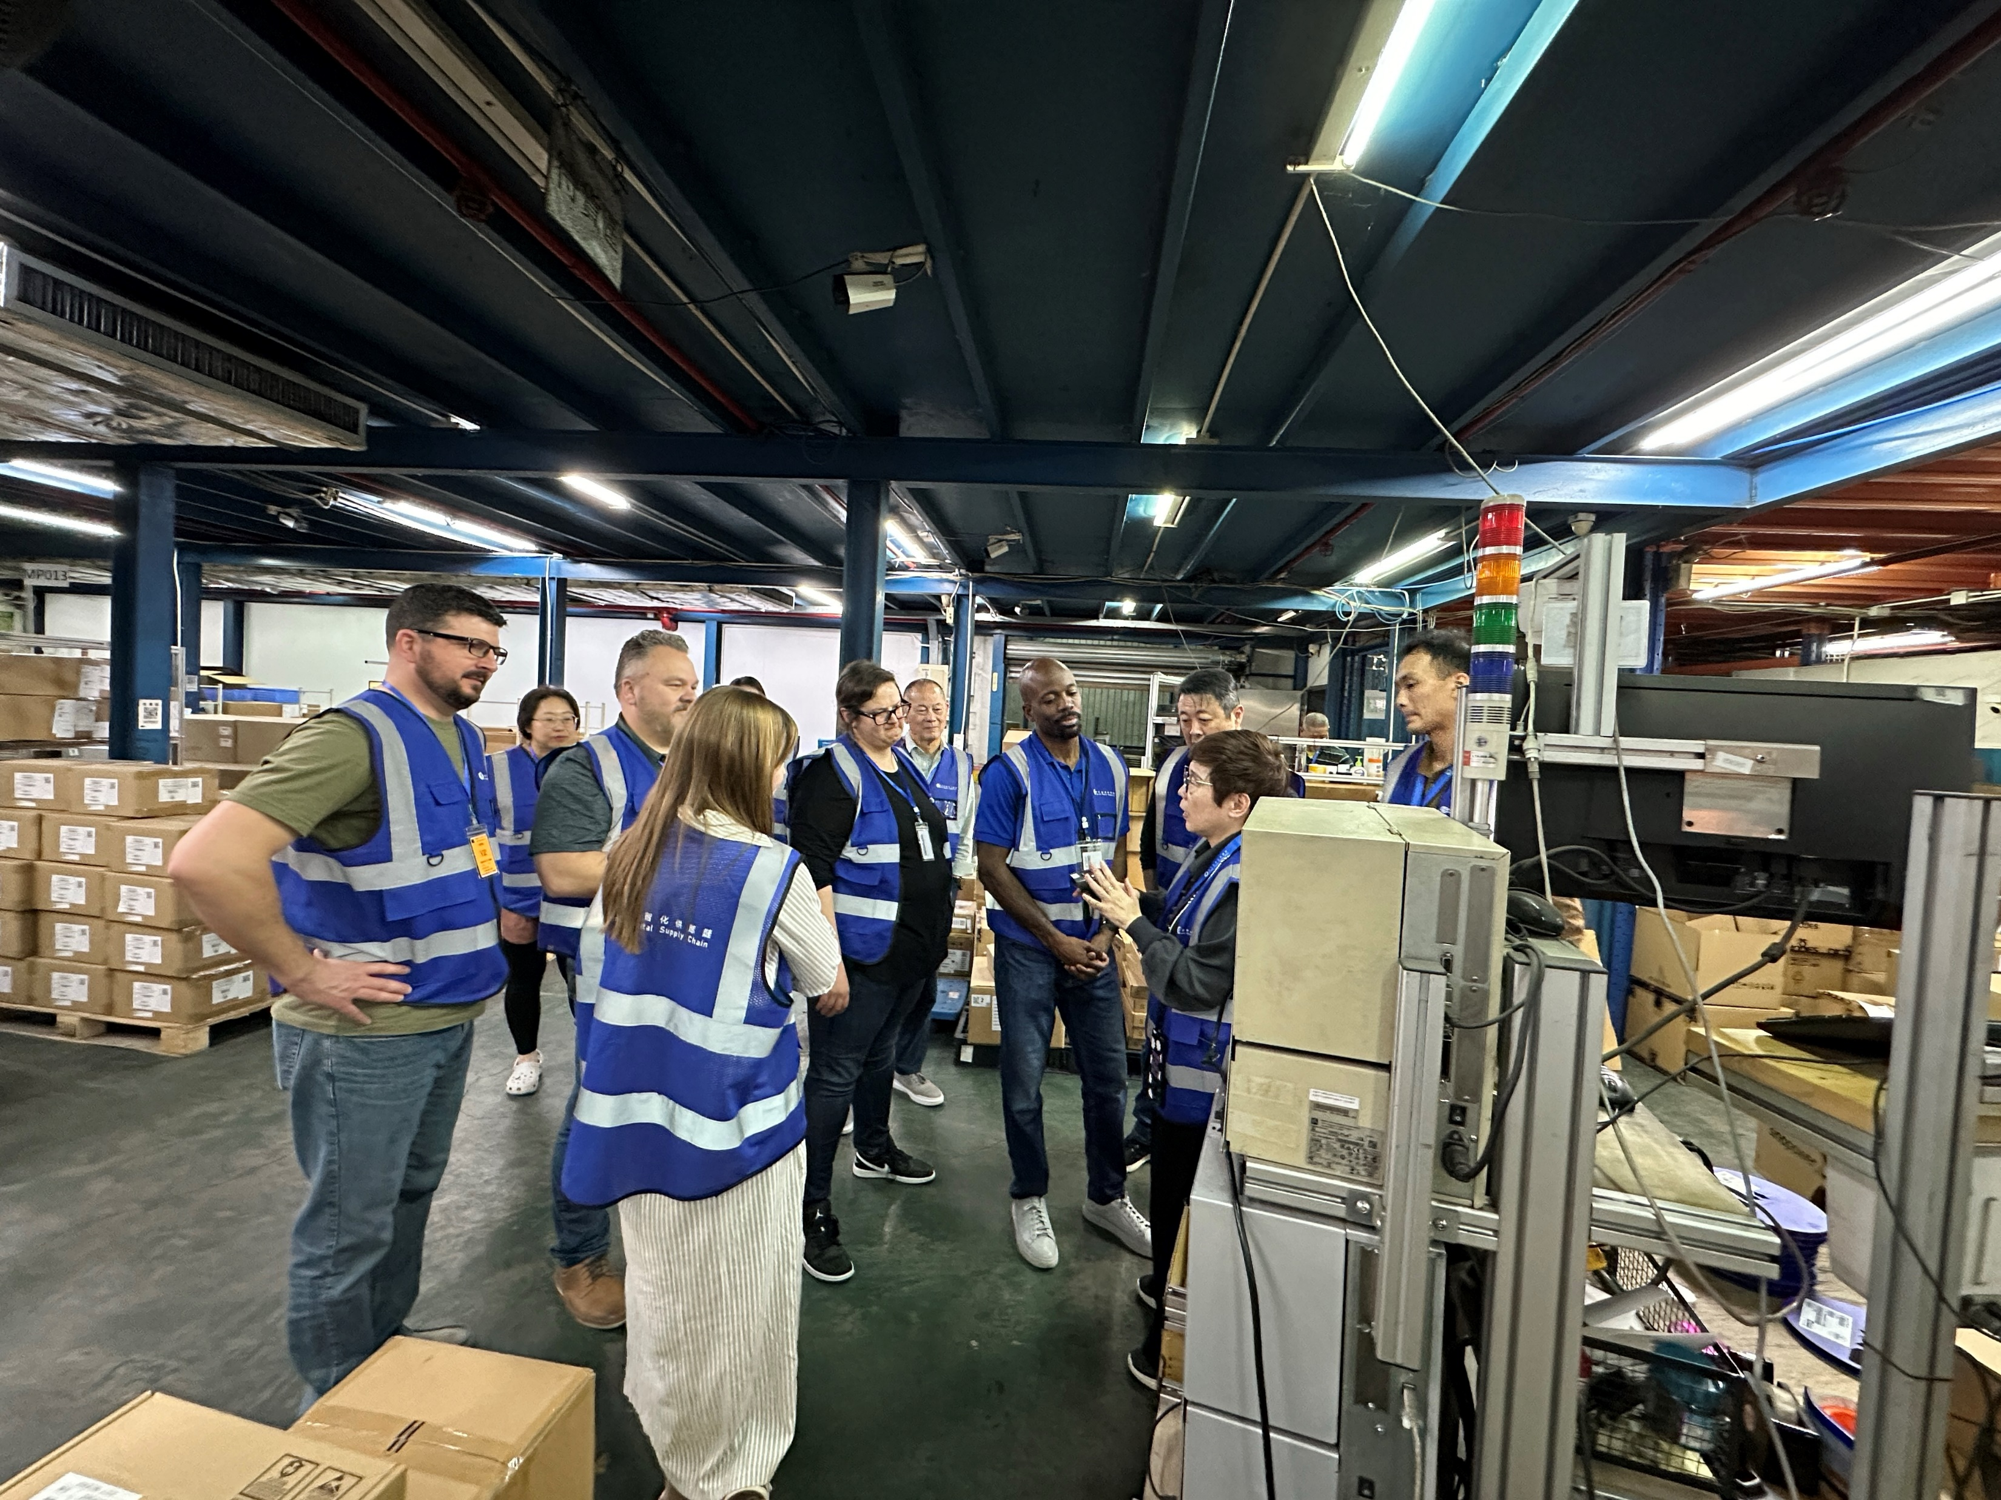
Amazon RL Team 2023/Q4 QBR with Spread Hong Kong
Site Tour
Introduce Spread’s
“Second Brain System”
Components
Operation Model
2024/03/21

Slide 13
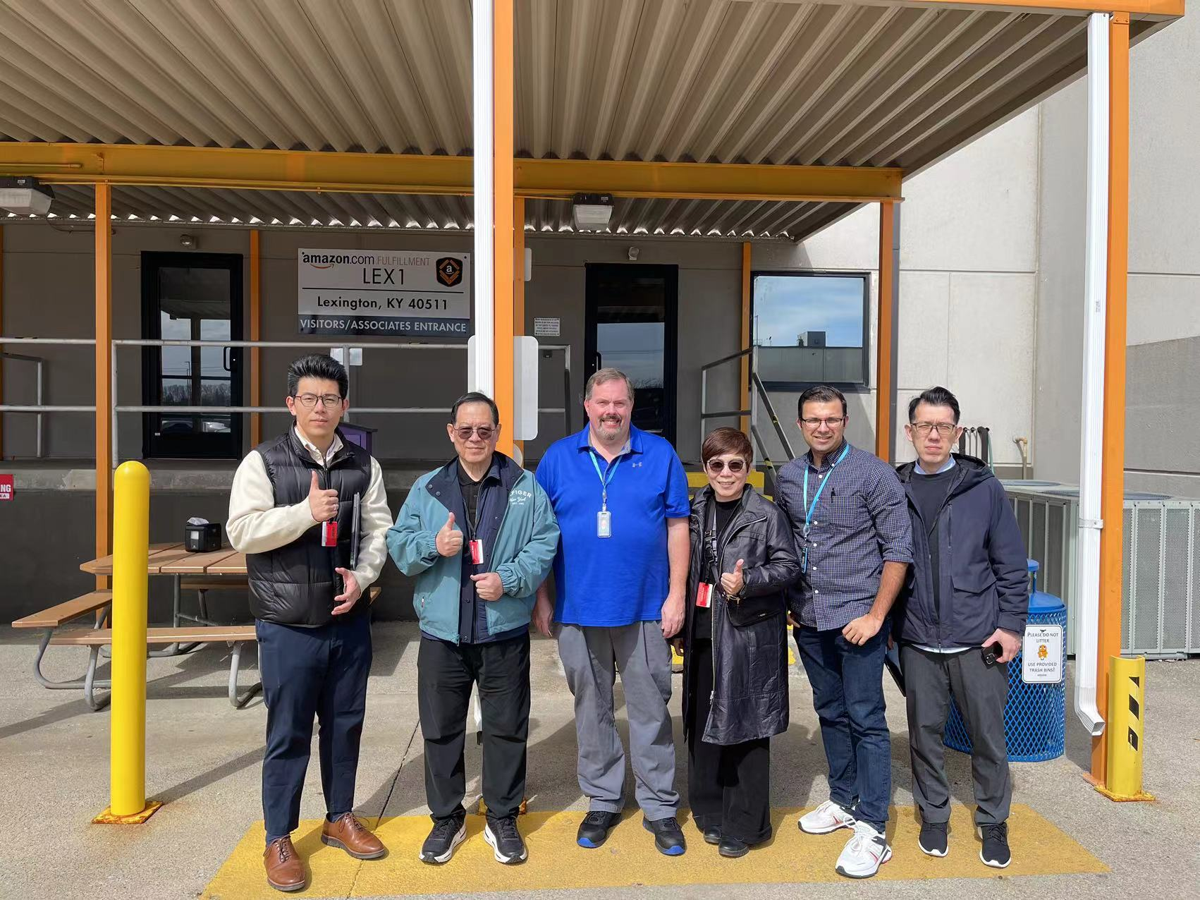
Spread’s Team Visiting LEX 1
Shop Floor
Project
Understand the
Inbound and Outbound Flows
Of Amazon Devices
2024/3/26

Slide 14
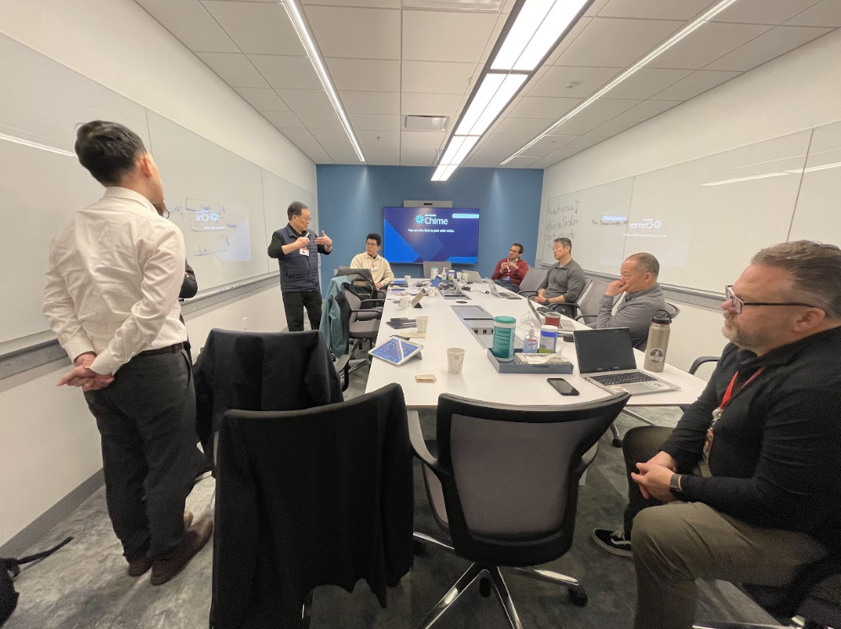
White Board Meeting at San Jose
Shop Floor
Project
Discussion how Spread can
Re-engineer and Design
the Shop Floor System
2024/3/28

Slide 15
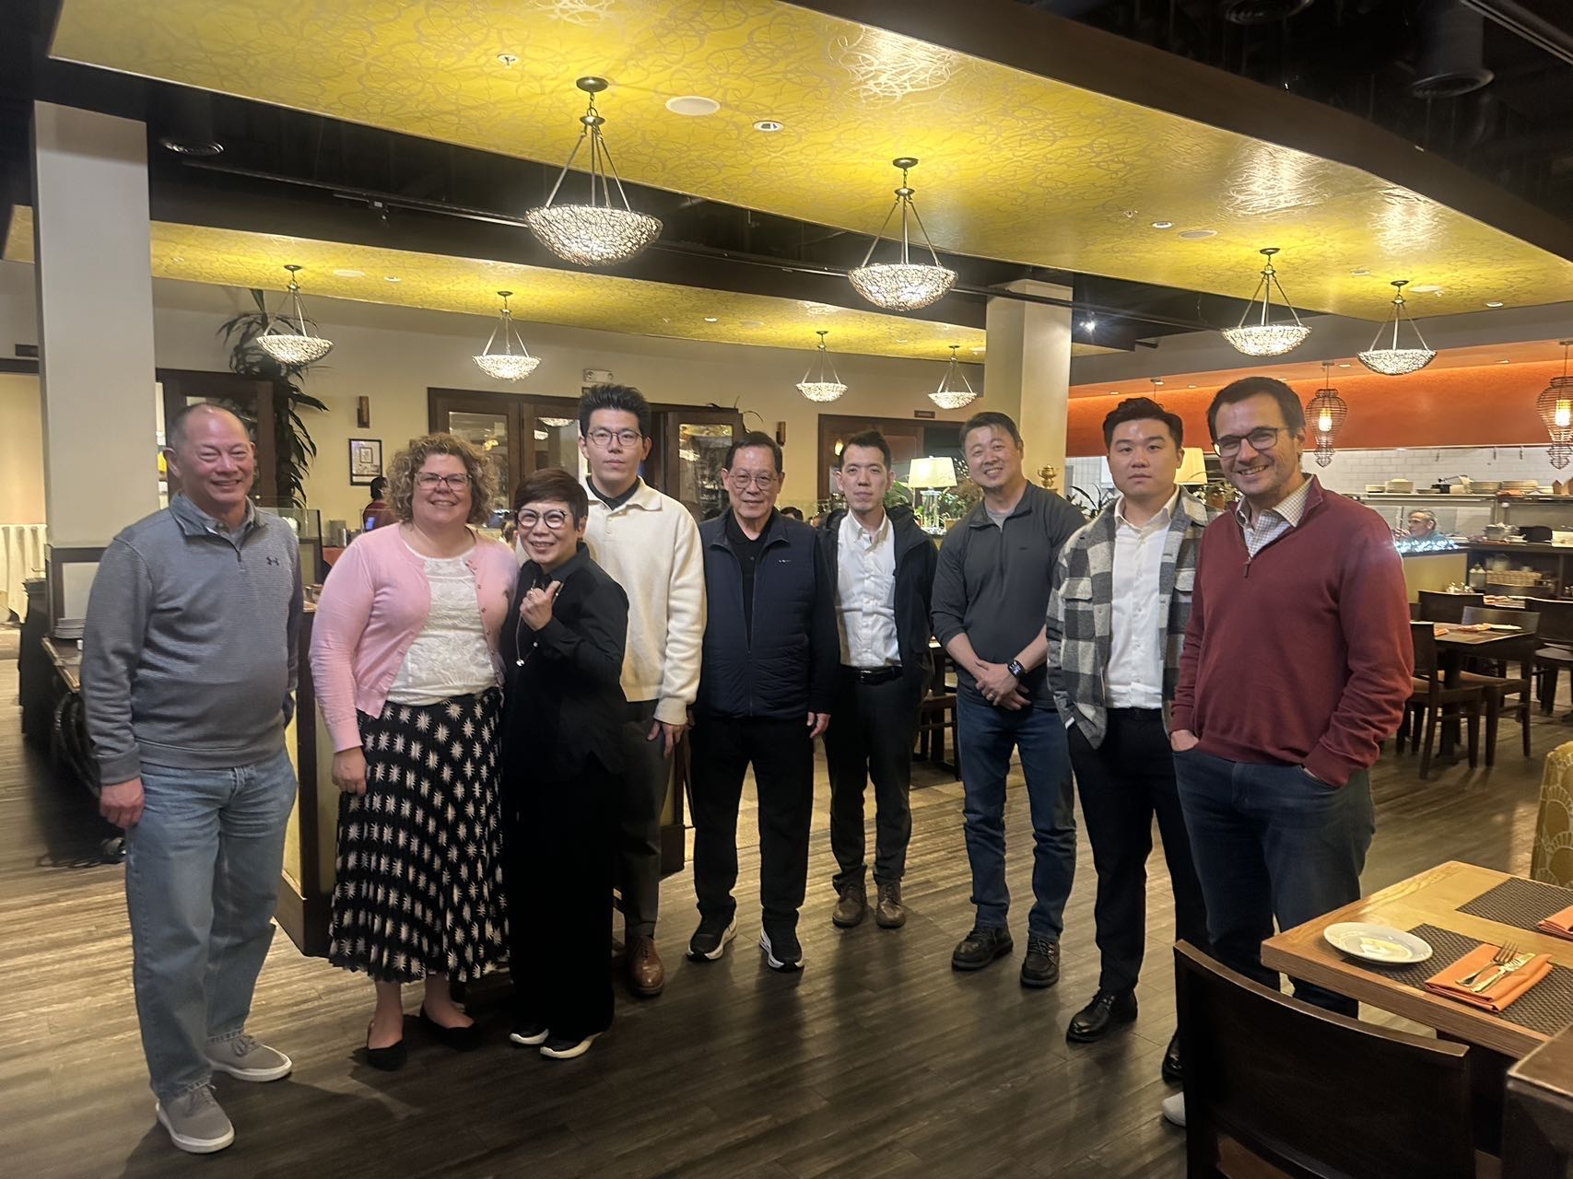
Amazon and Spread Team Dinner
Shop Floor
Project
Team Dinner with
Colleen, Andrew, Ken & Nikos
2024/3/28

Slide 16
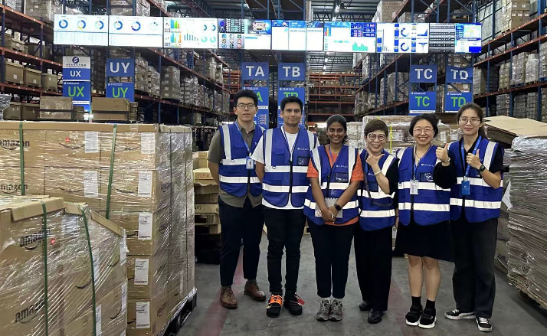
Amazon Engineer Team Visiting Spread Hong Kong
Test Engineer
Jhon and Rashmi
Welcome
2024/5/24

Slide 17
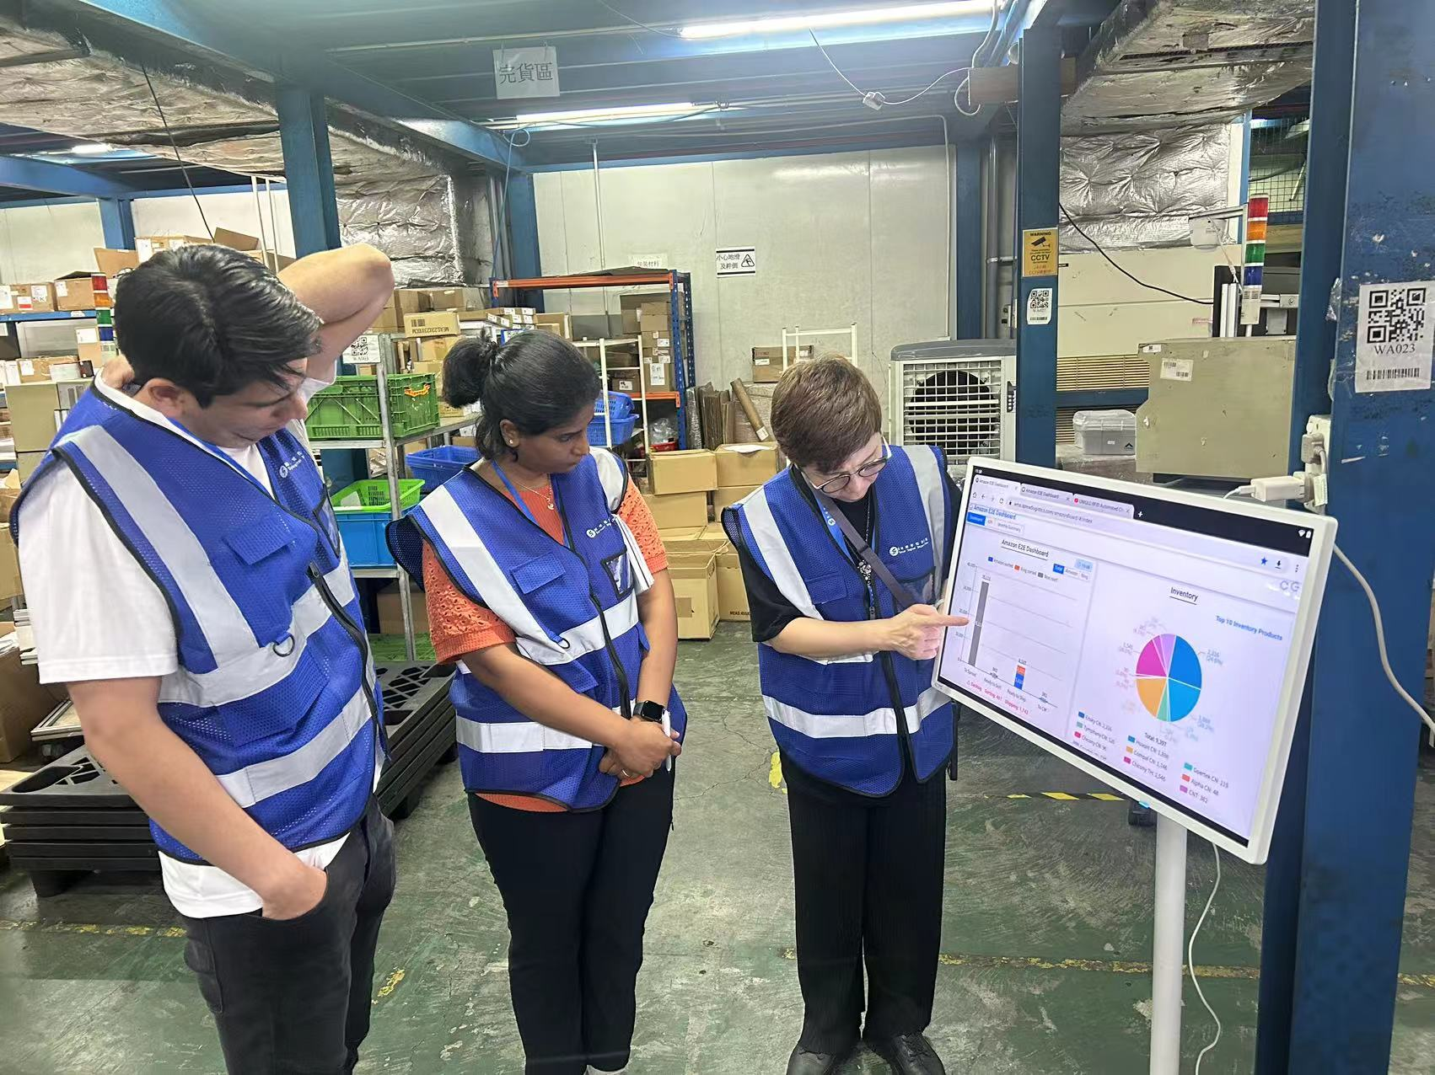
Site Tour
Introduce Spread’s
“Real-Time”
&
“Data-Driven”
Amazon E2E
Dashboard
2024/5/24

