Slide 1
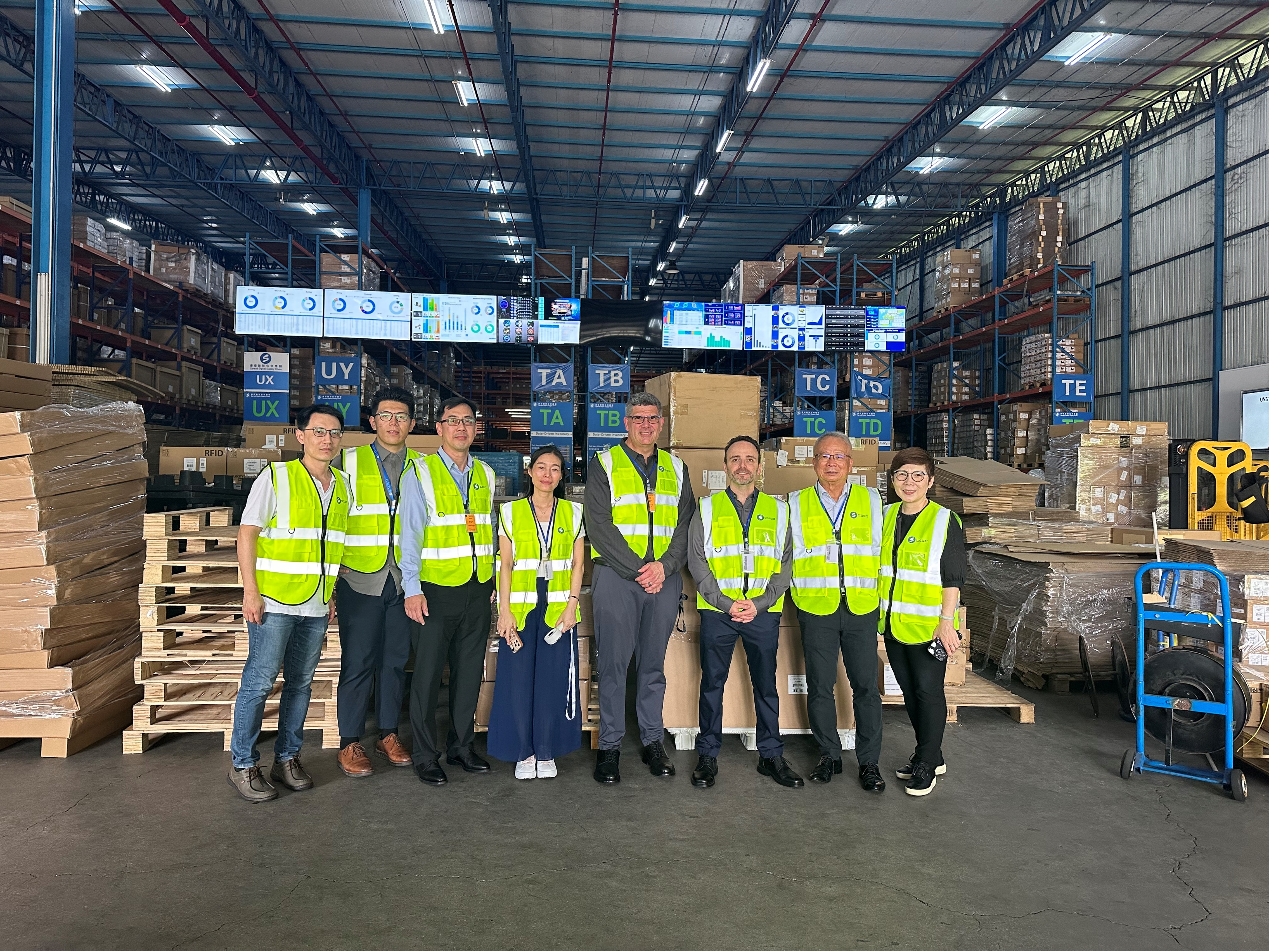
Heilind CEO & Team Visit Spread Hong Kong
Welcome
Robert W. Clapp
Scott Jacobs
William Sim
William Neo
Kwan Lin

Slide 2
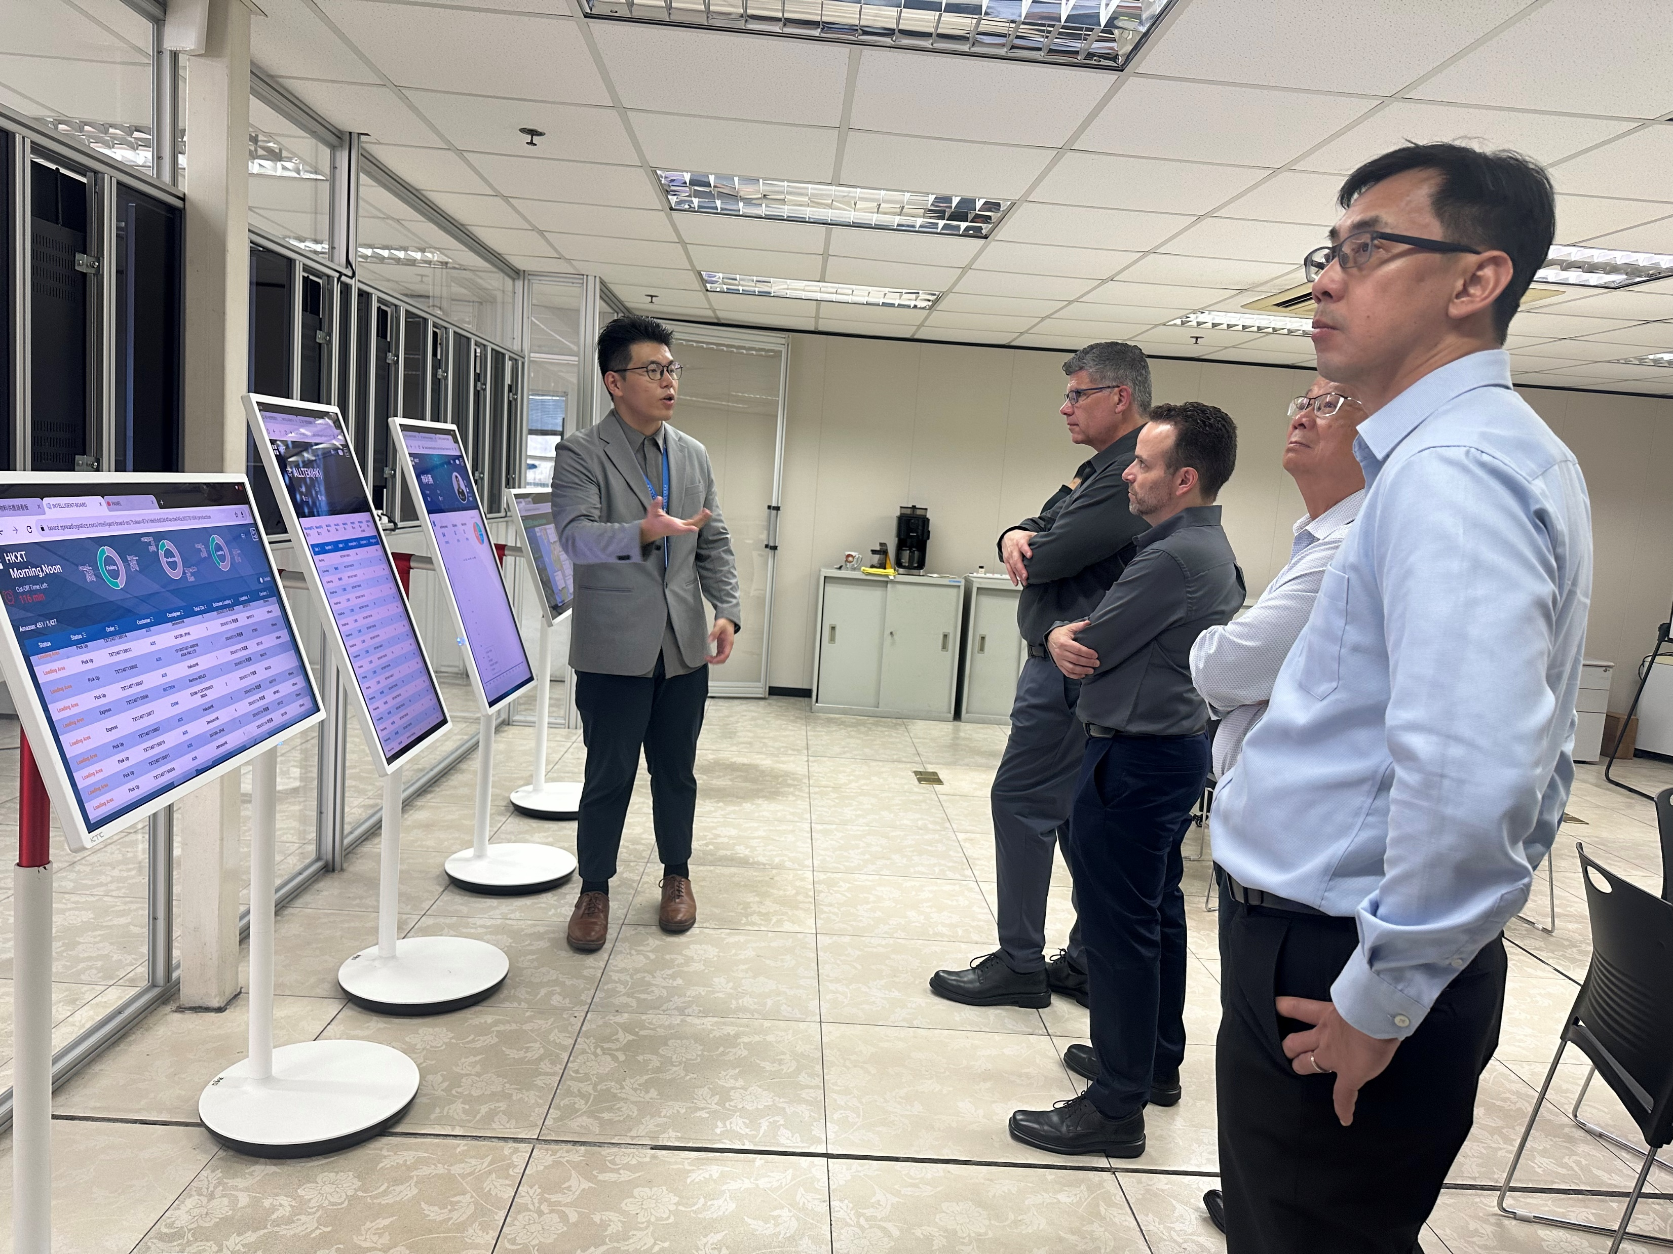
Heilind CEO & Team Visit Spread Hong Kong
Welcome
Robert W. Clapp
Scott Jacobs
William Sim
William Neo
Kwan Lin

Slide 3
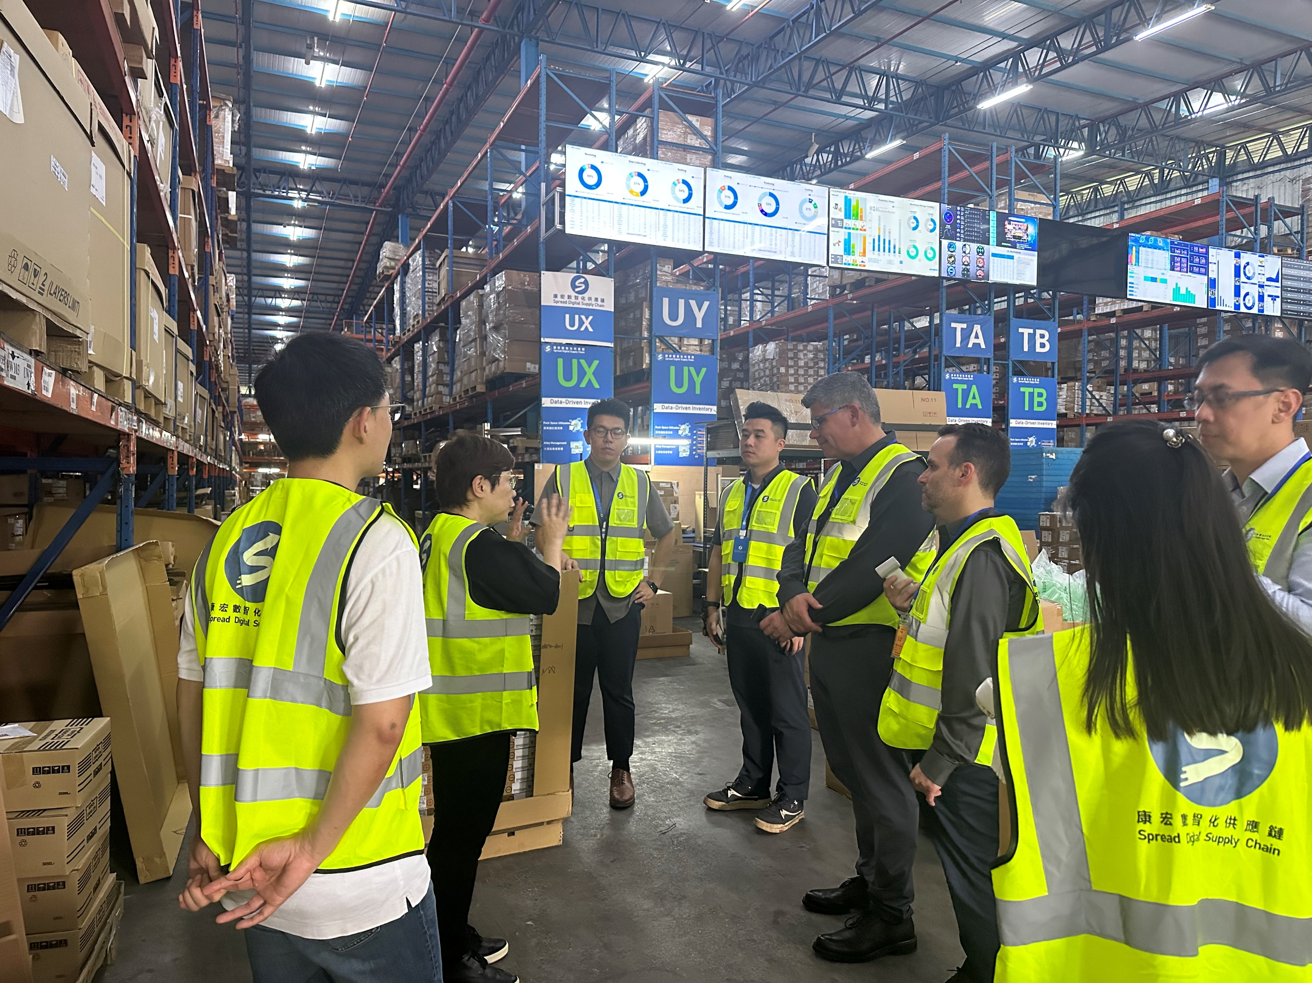
Heilind CEO & Team Visit Spread Hong Kong
Welcome
Robert W. Clapp
Scott Jacobs
William Sim
William Neo
Kwan Lin

Slide 4
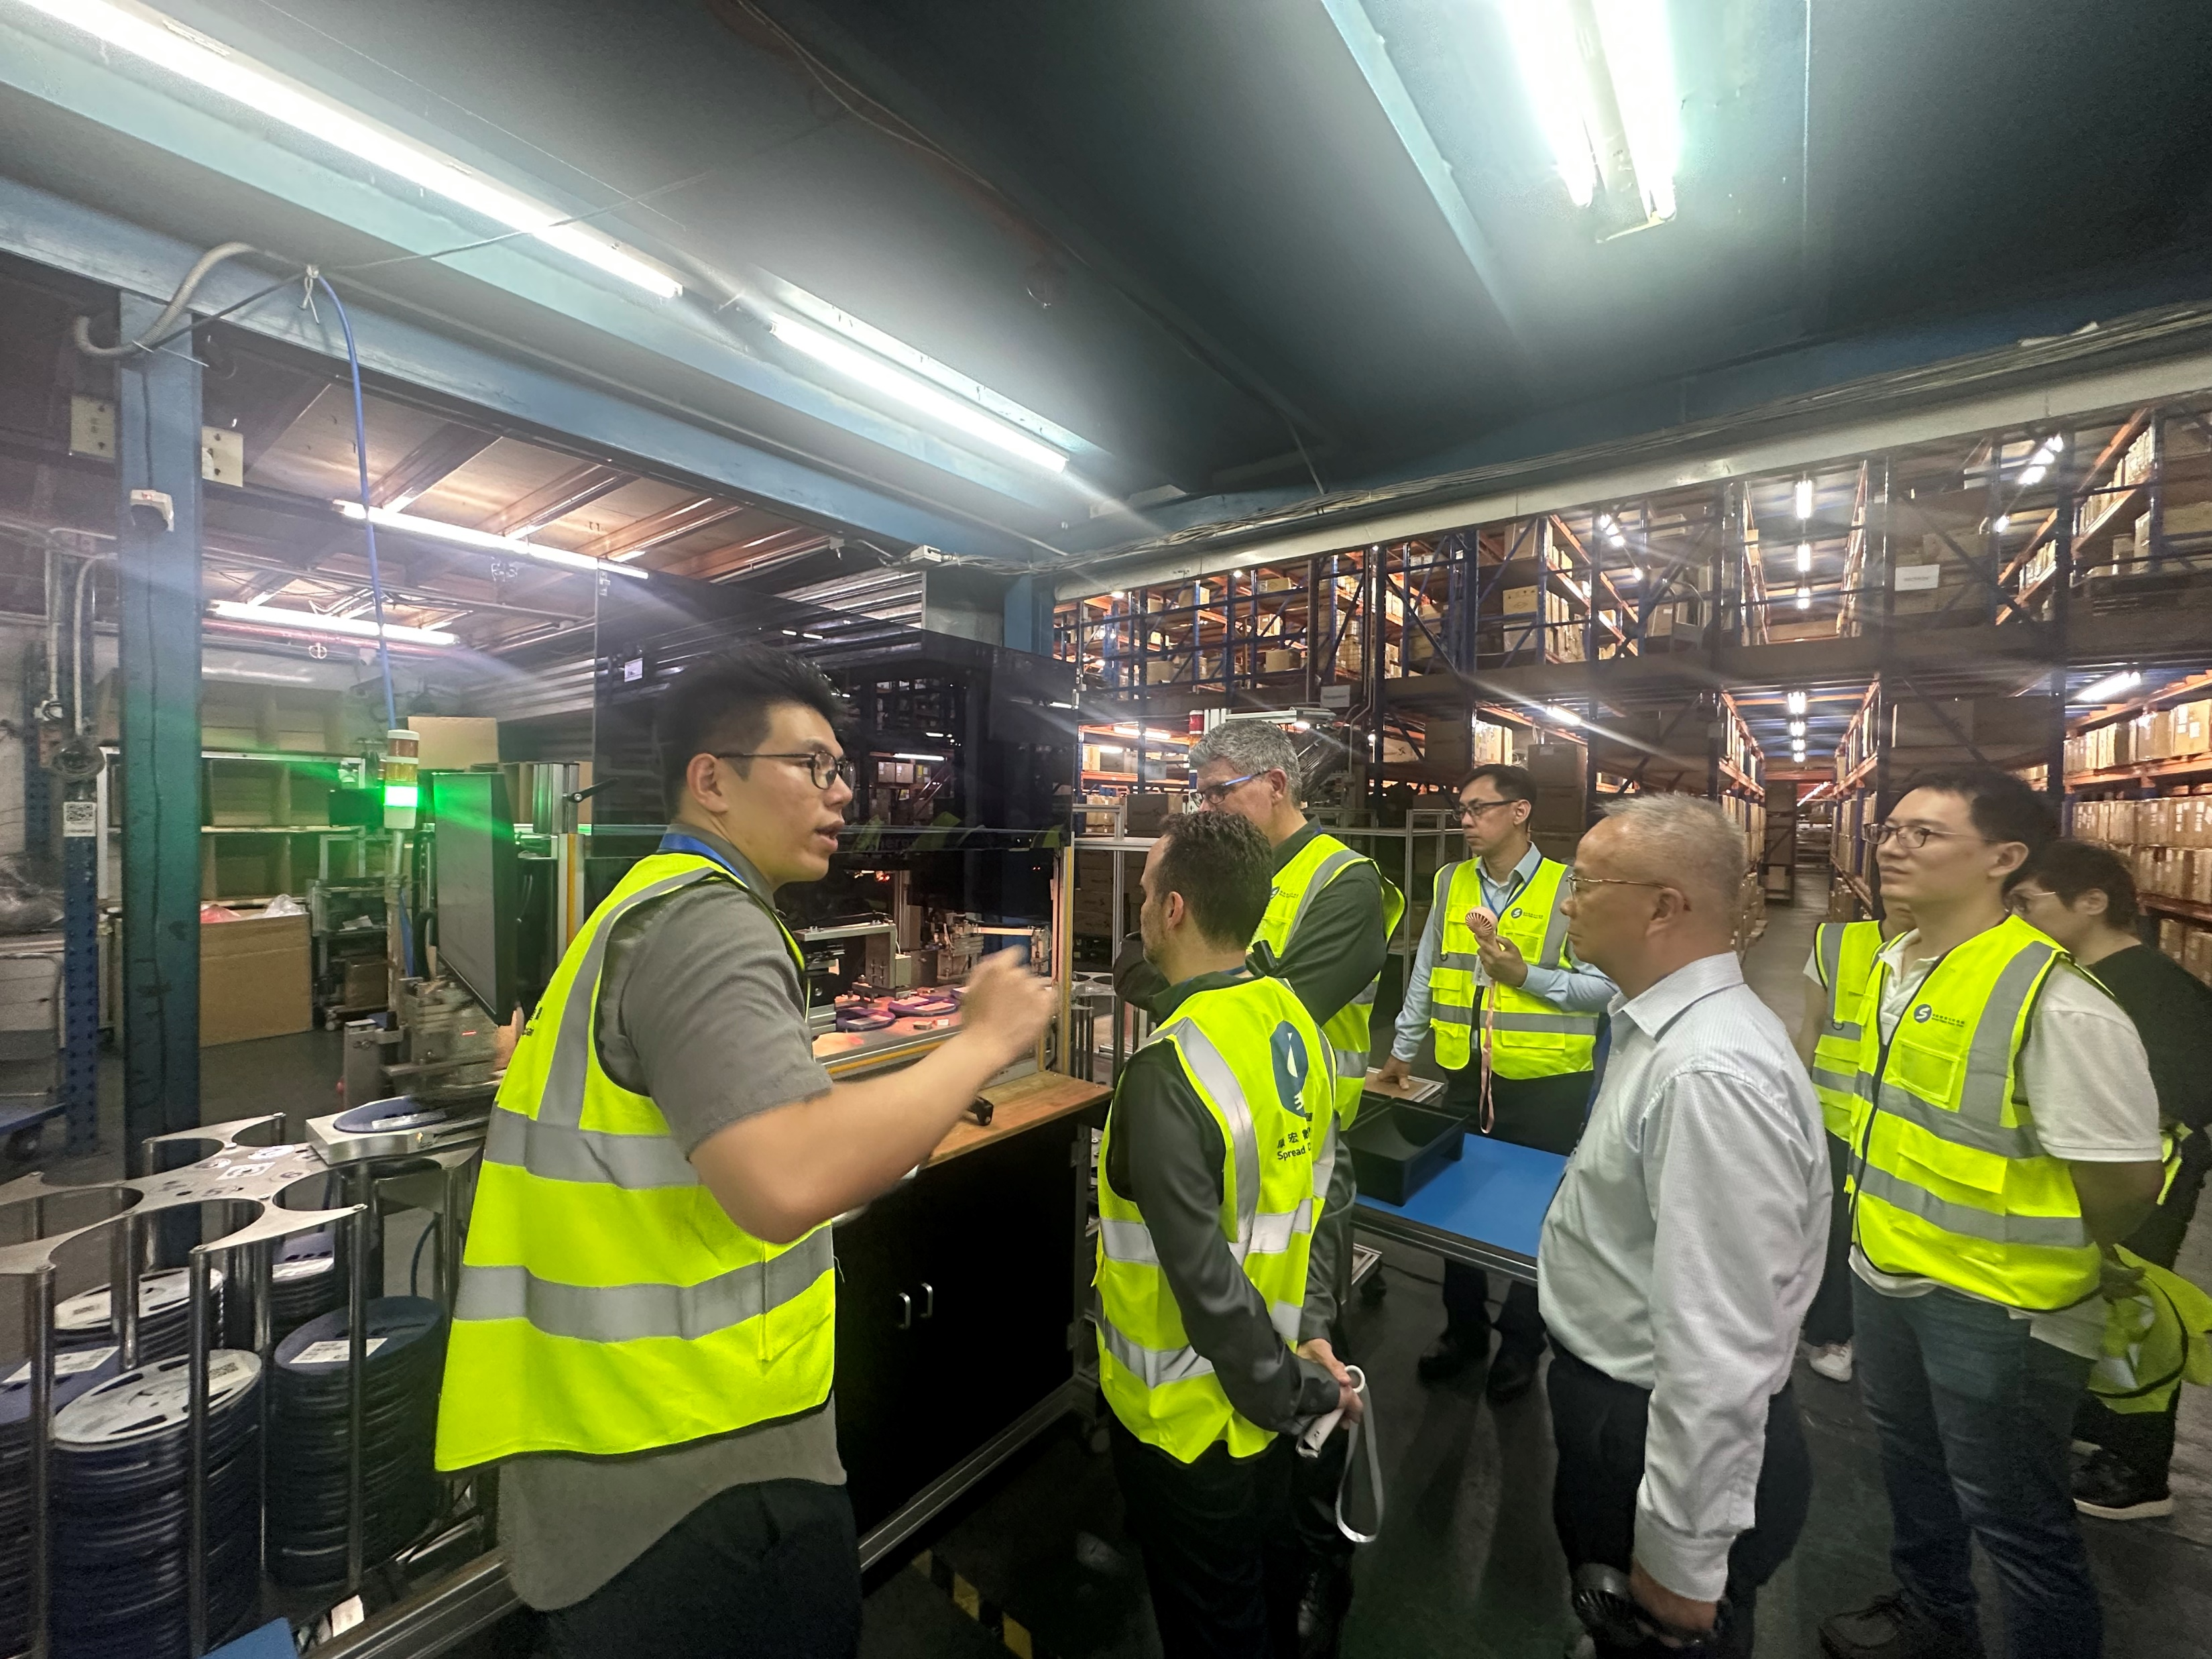
Heilind CEO & Team Visit Spread Hong Kong
Welcome
Robert W. Clapp
Scott Jacobs
William Sim
William Neo
Kwan Lin

Slide 5
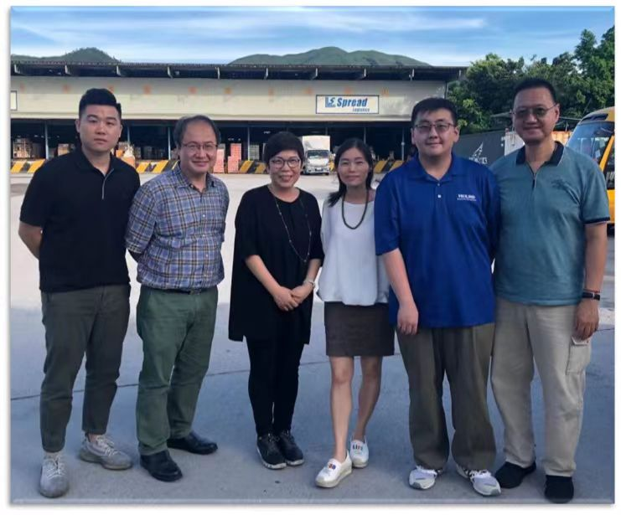
Kwan Lin Visit: Explored the Value of Spread
Phase One
Know Each Other
2020/September

Slide 6

Heilind Engagement with Spread Taiwan
Phase Two
Collaboration
Engagement
2021/January

Slide 7
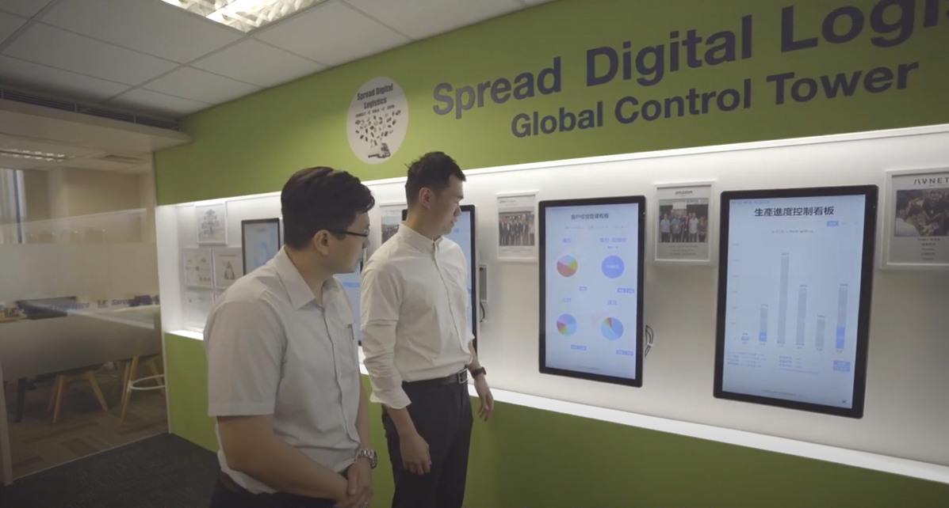
Heilind Engagement with Spread Taiwan
Phase Two
Heilind and Spread deliver
Joint-Service Committments

Slide 8
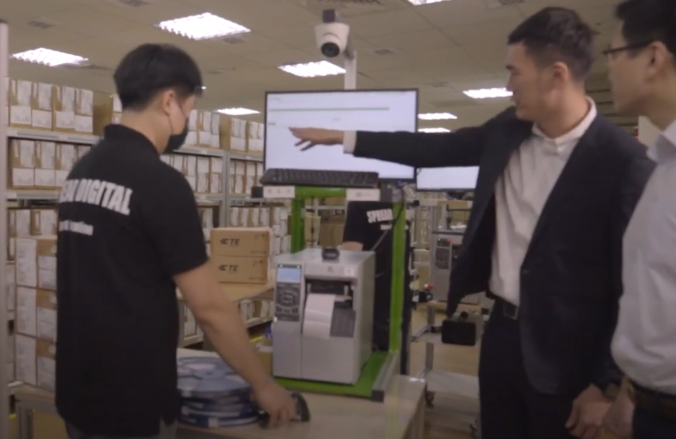
Heilind Engagement with Spread Taiwan
Phase Two
Fulfill Heilind Customers’
Service Expectations

Slide 9
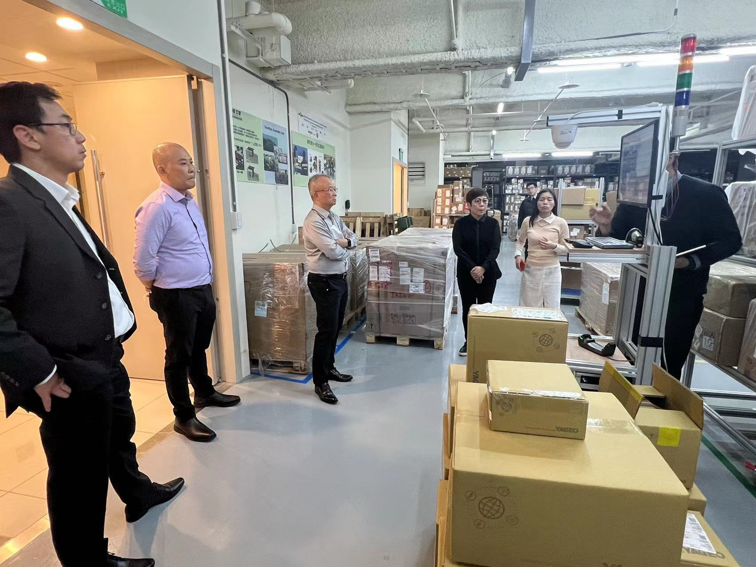
Experience Journey : Kwan Lin & APAC Management Team in Spread Taiwan
Phase Three
APAC Team’s
Experience Journey
2023/February

Slide 10
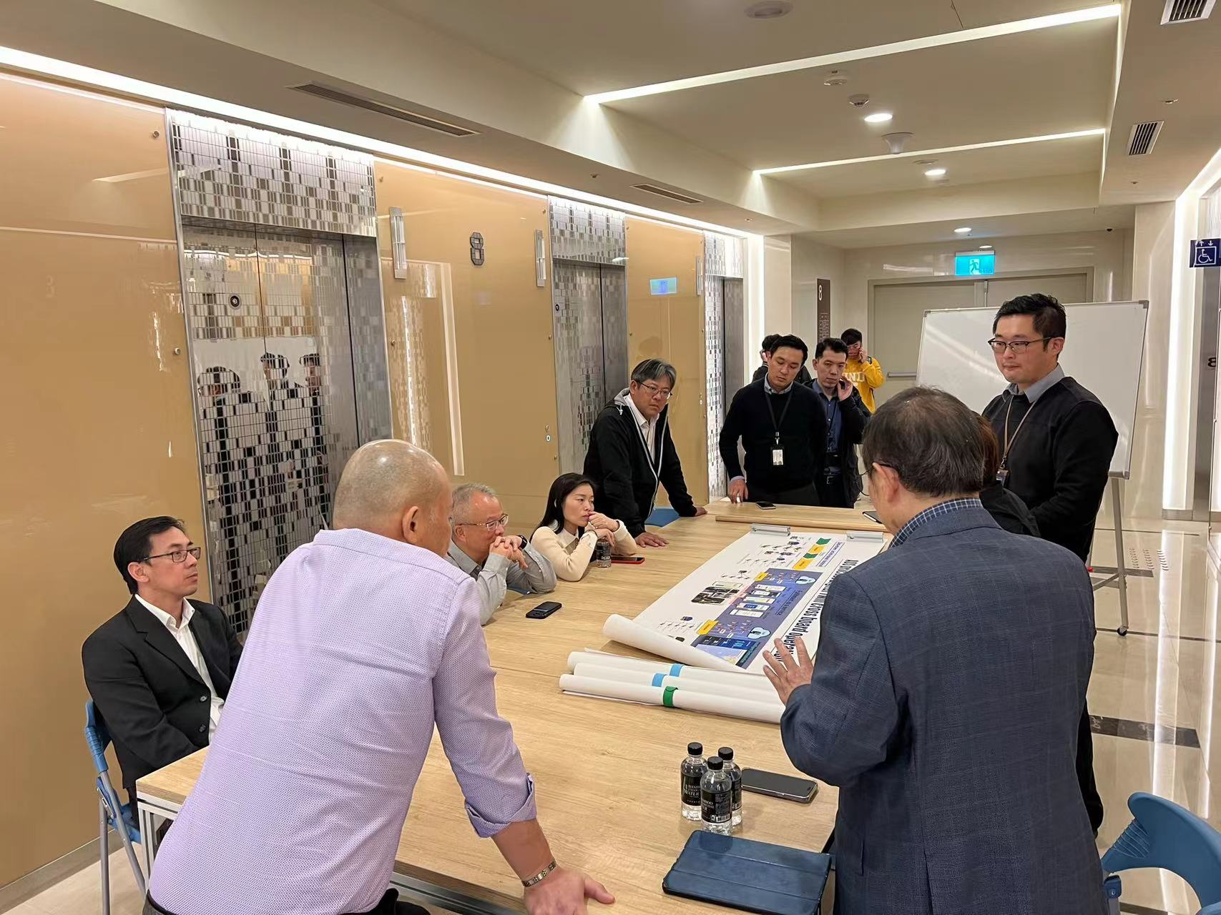
Experience Journey : Kwan Lin & APAC Management Team in Spread Taiwan
Phase Three
Introduce Spread’s
Core Competence
“Real-Time”
&
“Data-Driven”
Digital Twin

Slide 11
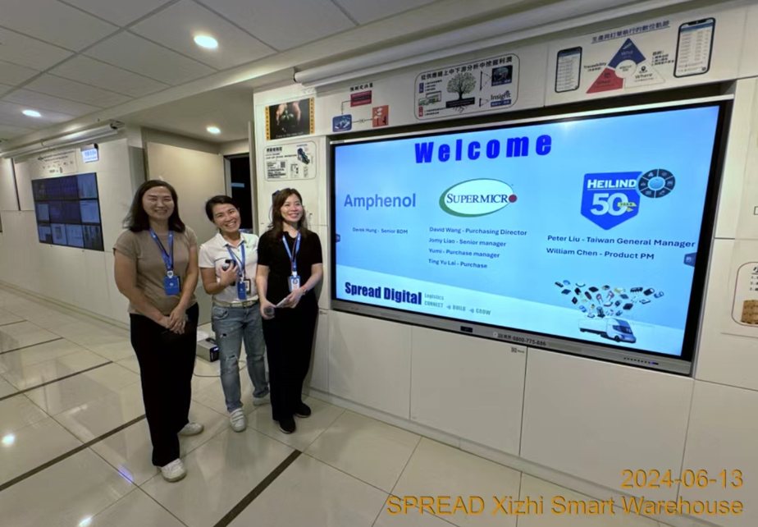
Heilind & Spread Collaboration for Supermicro & Amphenol Introduction in Taiwan
Phase Four
Peter Liu & Supermicro
New Business Introduction
2024/June

Slide 12
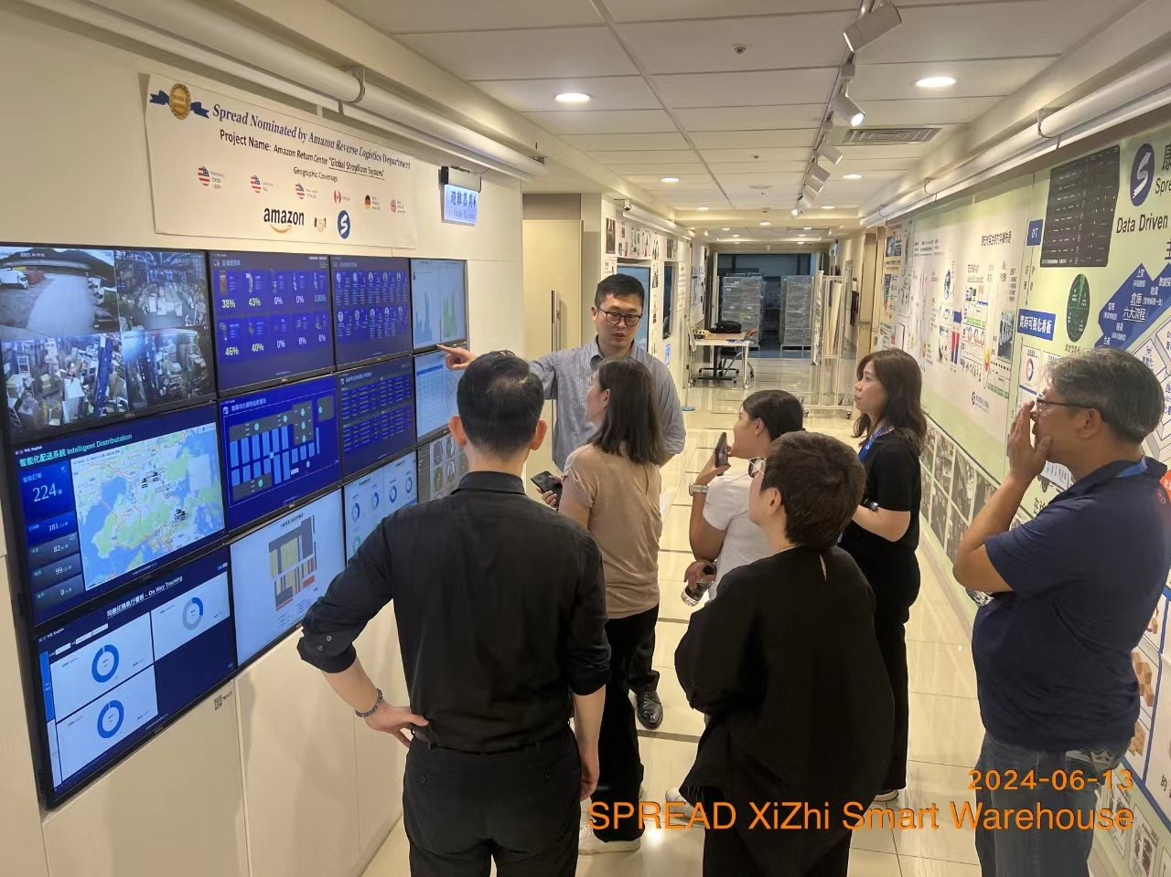
Heilind & Spread Collaboration for Supermicro & Amphenol Introduction in Taiwan
Phase Four
Peter Liu & Supermicro
Experience Journey:
Dashboards

Slide 13
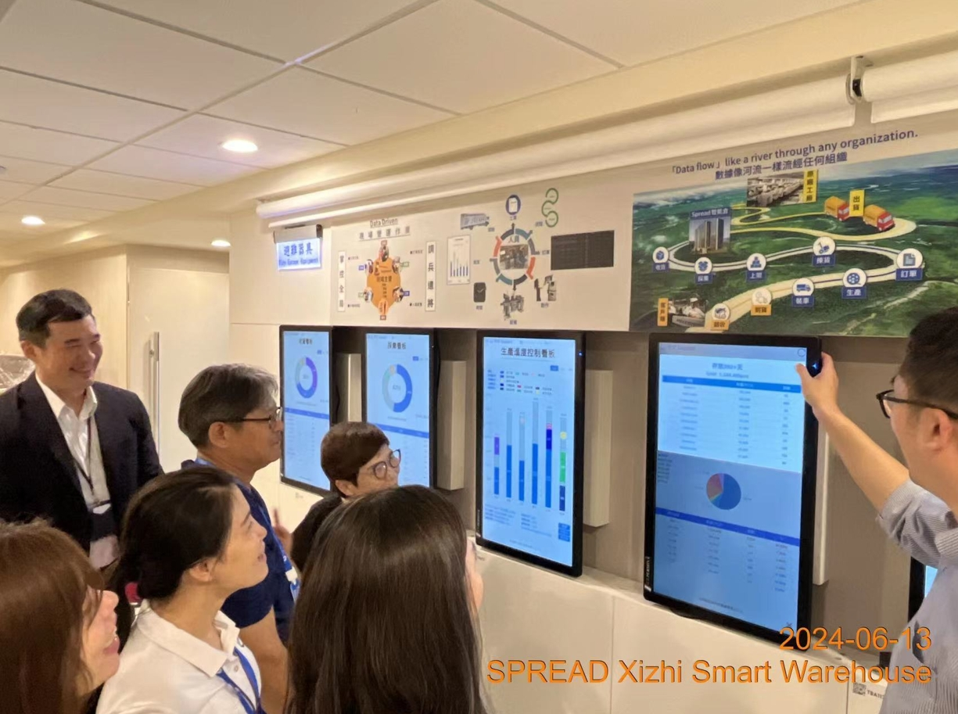
Heilind & Spread Collaboration for Supermicro & Amphenol Introduction in Taiwan
Phase Four
Peter Liu demonstrates
Real-Time Model:
Inventory Optimization

